Slide 1

Topic 10: Generalized linear mixed effects models
Chapter 9

Slide 2
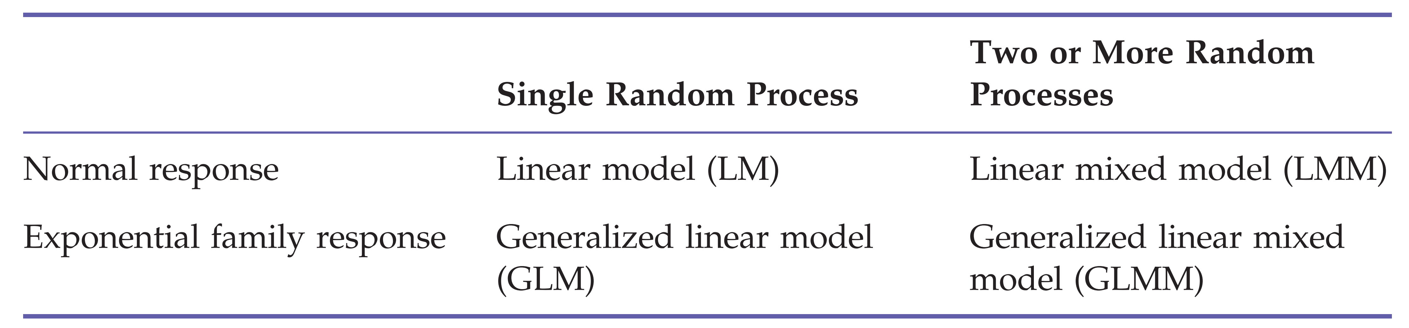
„The core of modern applied statistics“

Slide 3
GLMM in R
lme4::glmer()
Other packages
glmmADMB: more flexible but also more complex and therefore slower
offers more link functions for e.g. beta or negative binomial distributions
can account for zero-inflated data
glmmTMB: recently developed as follow-up to glmmADMB (partly still under developement)

Slide 4
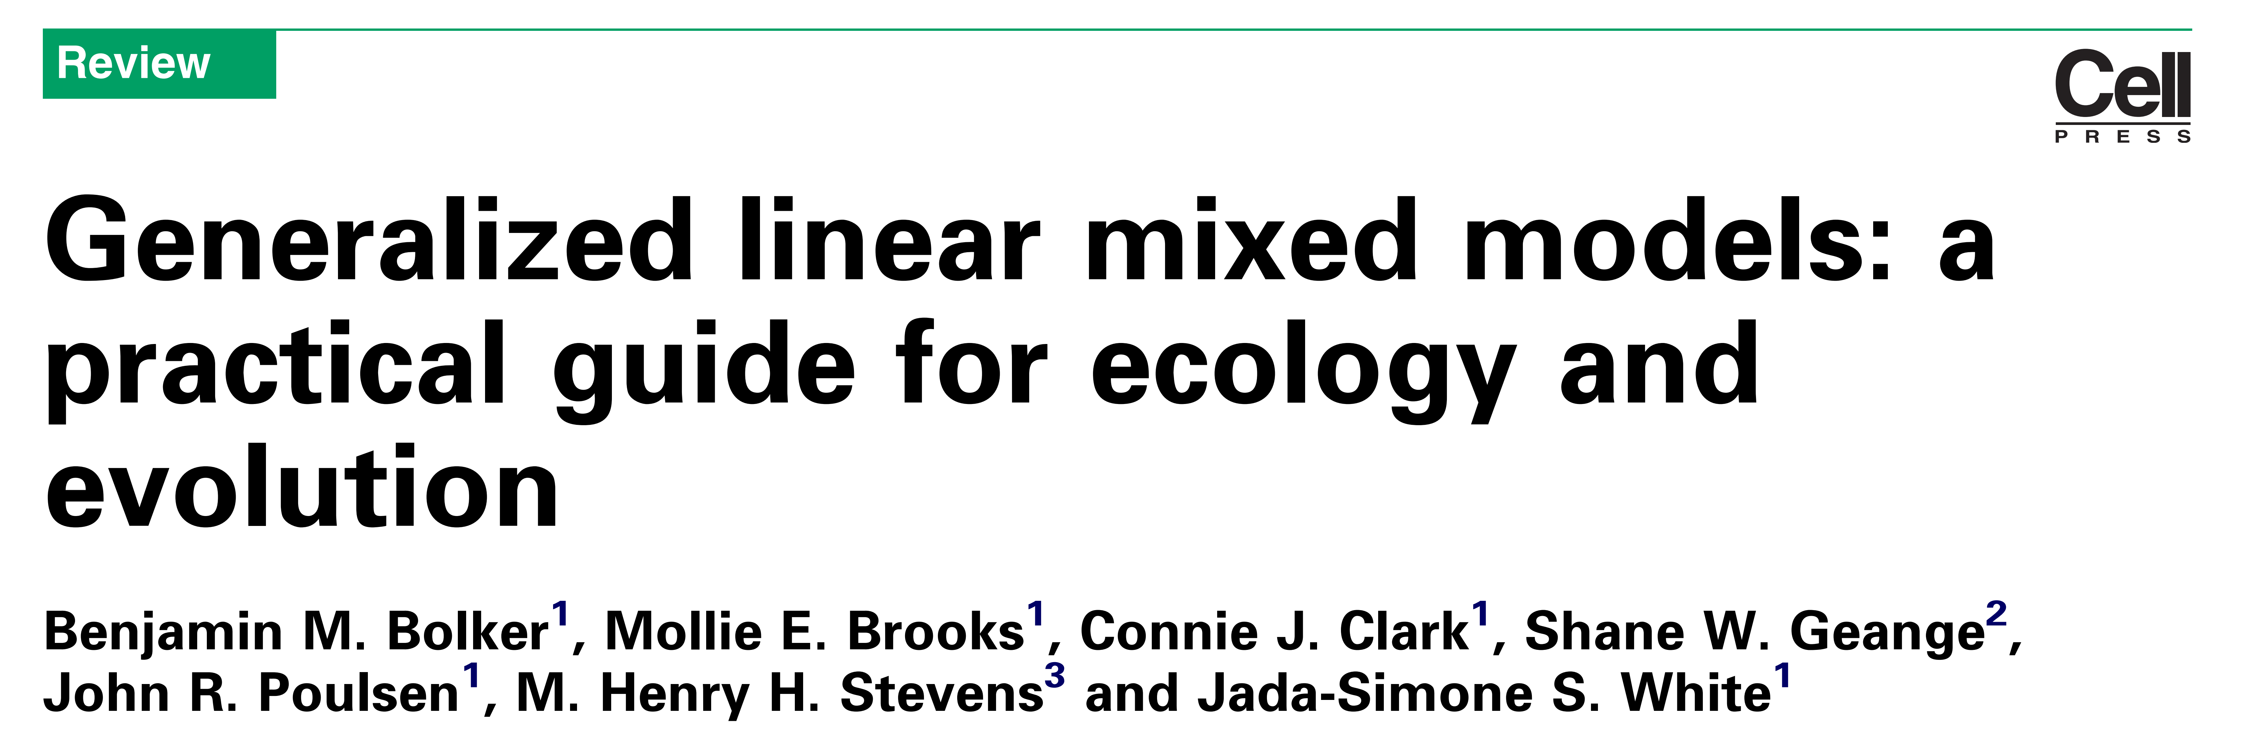
Help and info about GLMM
FAQ and overview about GLMM:
http://bbolker.github.io/mixedmodels-misc/glmmFAQ.html

